Slide 1

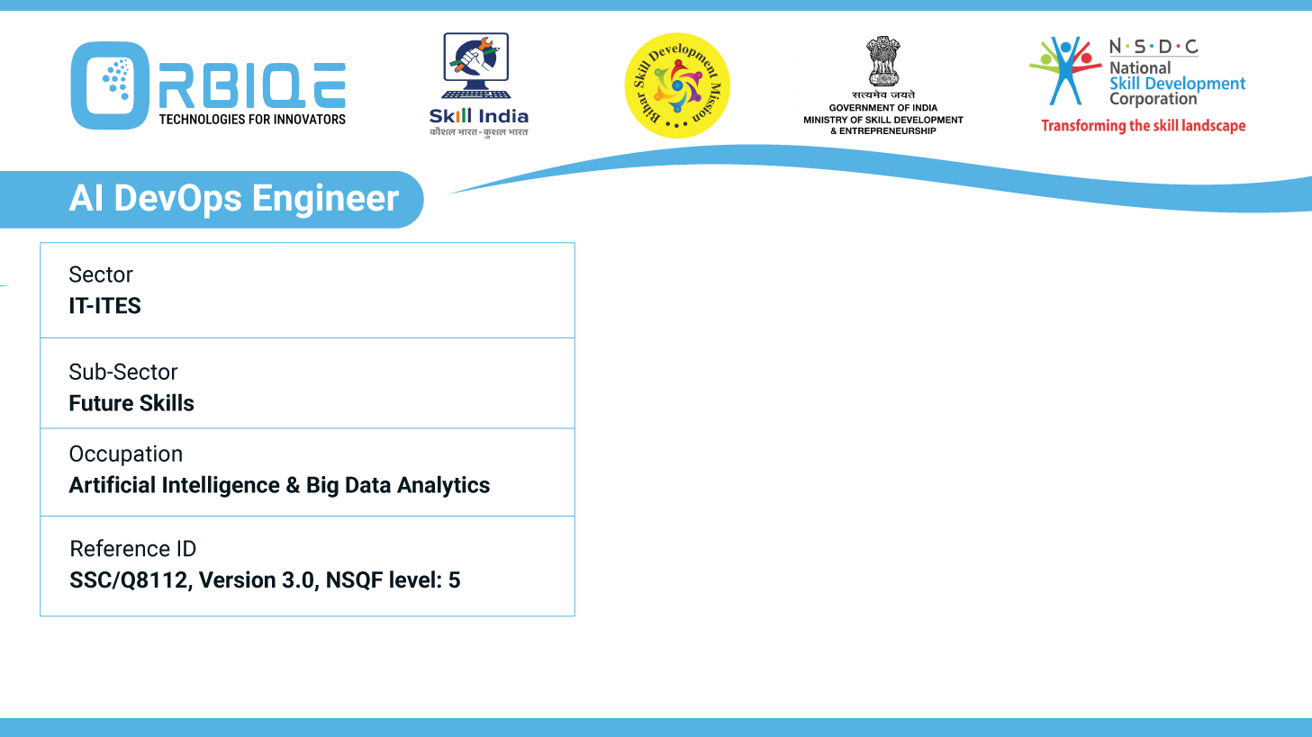
Name- Krishna Kant Dubey

Slide 2

Approaches to Configure Roles in Ansible

Slide 3
Agenda
Define roles for different components or services and apply configurations based on these roles
Organize playbooks into tasks and roles to manage configurations effectively
Utilize variables to customize configurations for different environments or hosts

Slide 4
Define roles for different components or services and apply configurations based on these roles

Slide 5
Organize playbooks into tasks and roles to manage configurations effectively

Slide 6
Utilize variables to customize configurations for different environments or hosts

Slide 7
Thank You

